Slide 1

Problem Statement and Team Details
Problem Statement: Space Safety objects detection
Team Name: AI INNOVATORS
Team Leader Name: MOHAMMAD ASIF BAIG
Institute Name:
Team Leader Email ID: mohammadasifbaig87@gmail.com
SESHADRI RAO GUDLAVALLERU ENGINEERING COLLEGE

Slide 2
Safety Object Detection is an AI-powered system that leverages computer vision and deep learning to automatically identify essential safety equipment such as helmets, vests, gloves, and fire extinguishers in real time. Traditional manual safety monitoring is slow, error-prone, and often fails to prevent accidents when workers do not wear or properly use protective gear. To solve this, the system integrates a deep learning model with cameras and OpenCV to continuously detect safety objects, while also supporting file uploads for image-based predictions. It instantly generates alerts for violations and stores detection results for compliance reporting, thereby enhancing workplace safety, reducing human error, and ensuring better safety compilance
Safety Object Detection

Slide 3
Methodology & Implementation
Our Approach to Safety Object Detection involves four main steps:
Data Collection & Labeling – We collect and annotate images of safety objects including Oxygen Tanks, Nitrogen Tanks, First Aid Boxes, Fire Alarms, Safety Switch Panels, Emergency Phones, and Fire Extinguishers to build a robust dataset.
Model Training – A deep learning object detection model (YOLO/Faster R-CNN) is trained on this dataset to accurately recognize and classify these safety objects.
System Integration – The trained model is integrated with OpenCV and a Streamlit interface, allowing users to either upload images or use real-time camera feeds for automatic detection.
Alerts & Reporting – The system generates instant alerts when objects are missing or misplaced and stores results for compliance reporting and safety analysis.

Slide 4
Technologies Used
Programming Language: Python (for AI/ML model development and integration)
Deep Learning Frameworks: TensorFlow / PyTorch (for training object detection models)
Object Detection Models: YOLOv5 / Faster R-CNN / SSD (for detecting Oxygen Tanks, Nitrogen Tanks, First Aid Boxes, Fire Alarms, Safety Switch Panels, Emergency Phones, and Fire Extinguishers)
Data Annotation Tools: LabelImg / Roboflow (for creating and managing labeled datasets)
Computer Vision Library: OpenCV (for handling image and video streams)
User Interface: Streamlit (for building an interactive interface with file upload and real-time camera detection options)

Slide 5
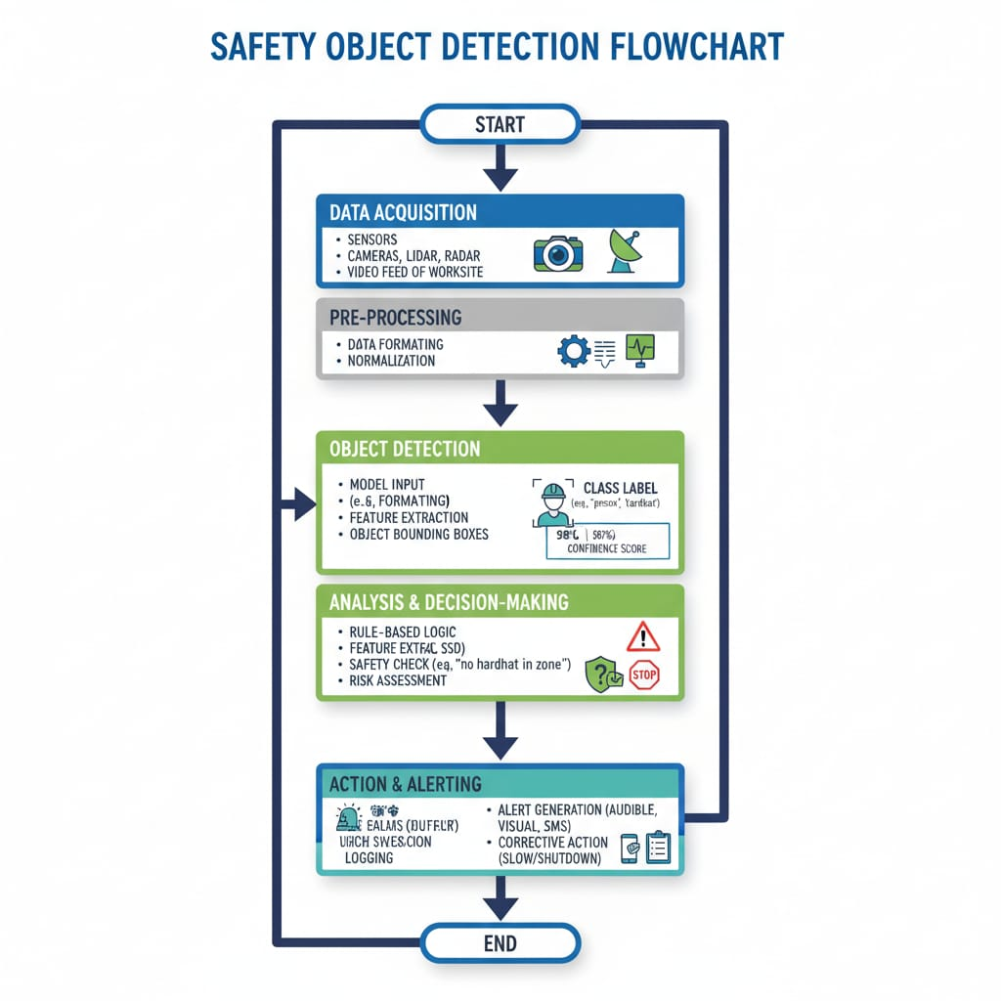

Slide 6
Feasibility and Market use
The system is highly feasible as it uses affordable and widely available technologies such as CCTV or IP cameras, open-source AI frameworks (TensorFlow, PyTorch), and deployment options on edge devices or cloud platforms. By leveraging pre-trained models and fine-tuning them for specific safety objects, development time and cost are significantly reduced. The integration of OpenCV for image/video processing and a Streamlit interface for easy user interaction makes the system practical and scalable. It can be seamlessly integrated into existing security and monitoring infrastructures in workplaces.
Potential Applications
Manufacturing Plants – Detecting and ensuring availability of safety objects such as fire extinguishers, first aid boxes, and safety switch panels.
Warehouses & Logistics – Monitoring placement of emergency equipment like fire alarms and emergency phones.
Oil, Gas & Chemical Plants – Real-time detection of Oxygen Tanks, Nitrogen Tanks, and other critical safety devices in hazardous zones.
Public Transport & Large Venues – Ensuring visibility and accessibility of fire safety and emergency equipment in airports, metros, and event spaces.

Slide 7
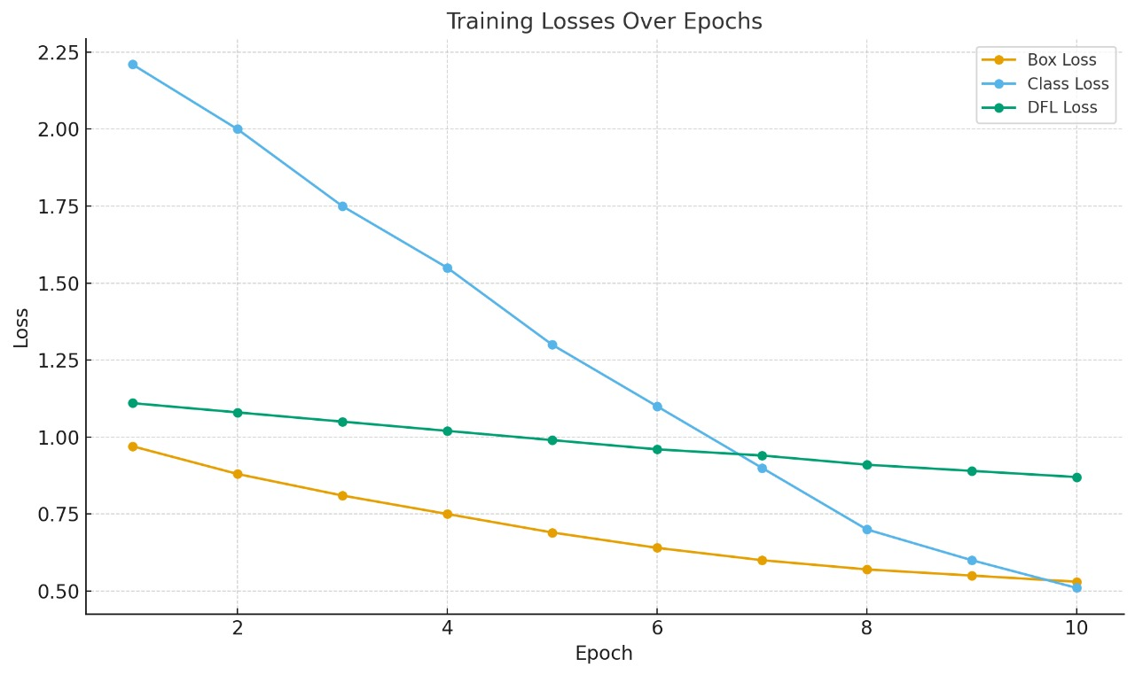
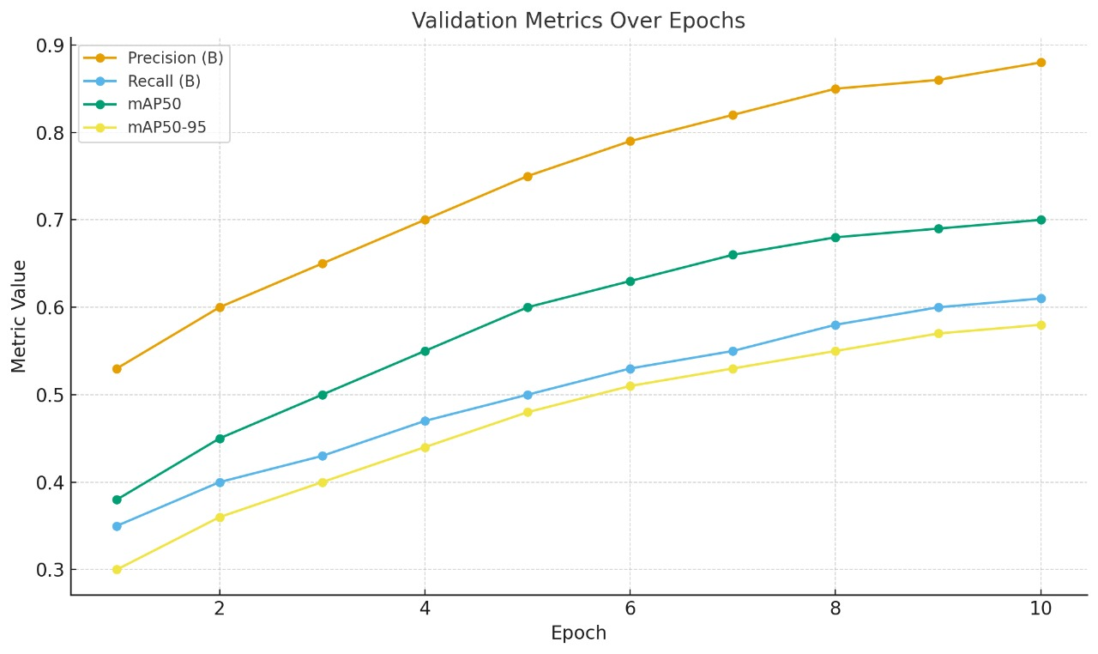
Results:
Box Loss dropped from 0.97 → 0.53
Class Loss dropped from 2.21 → 0.51
DFL Loss dropped from 1.11 → 0.87
Precision (B): improved from 0.53 → 0.88
Recall (B): improved from 0.35 → 0.61
mAP50: jumped from 0.38 → 0.70

Slide 8
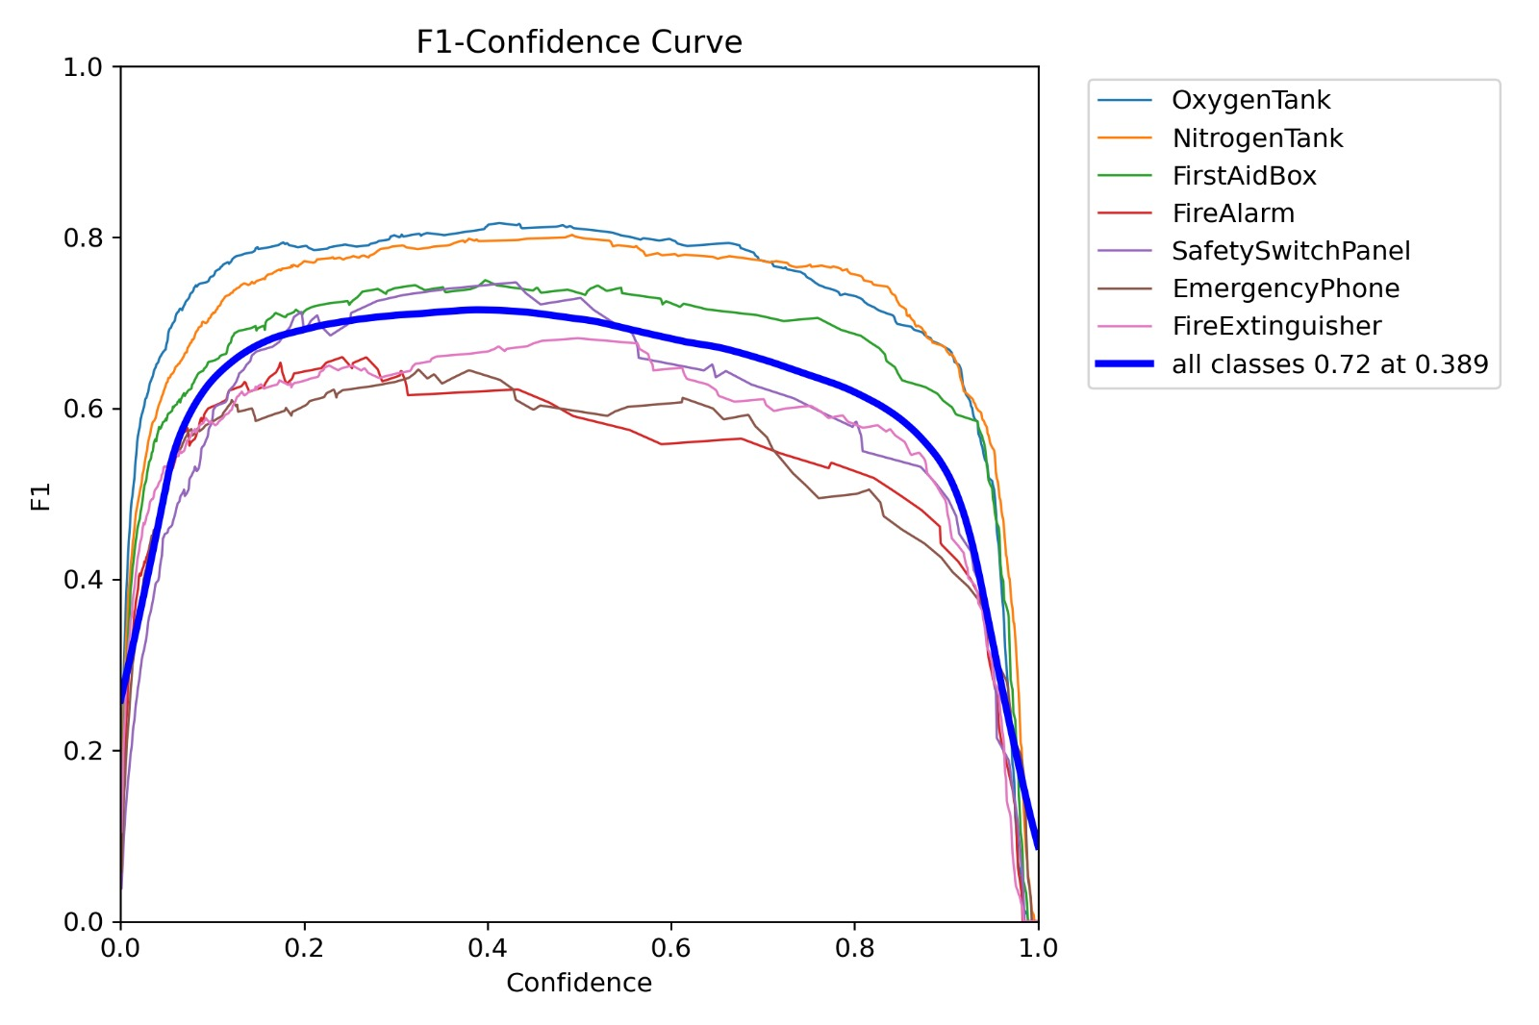
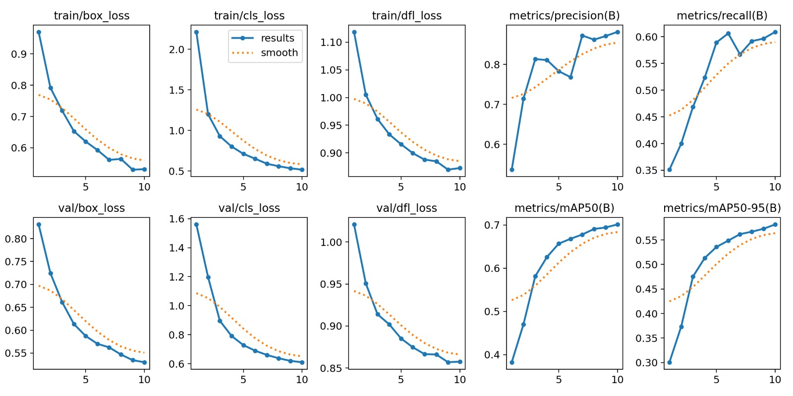
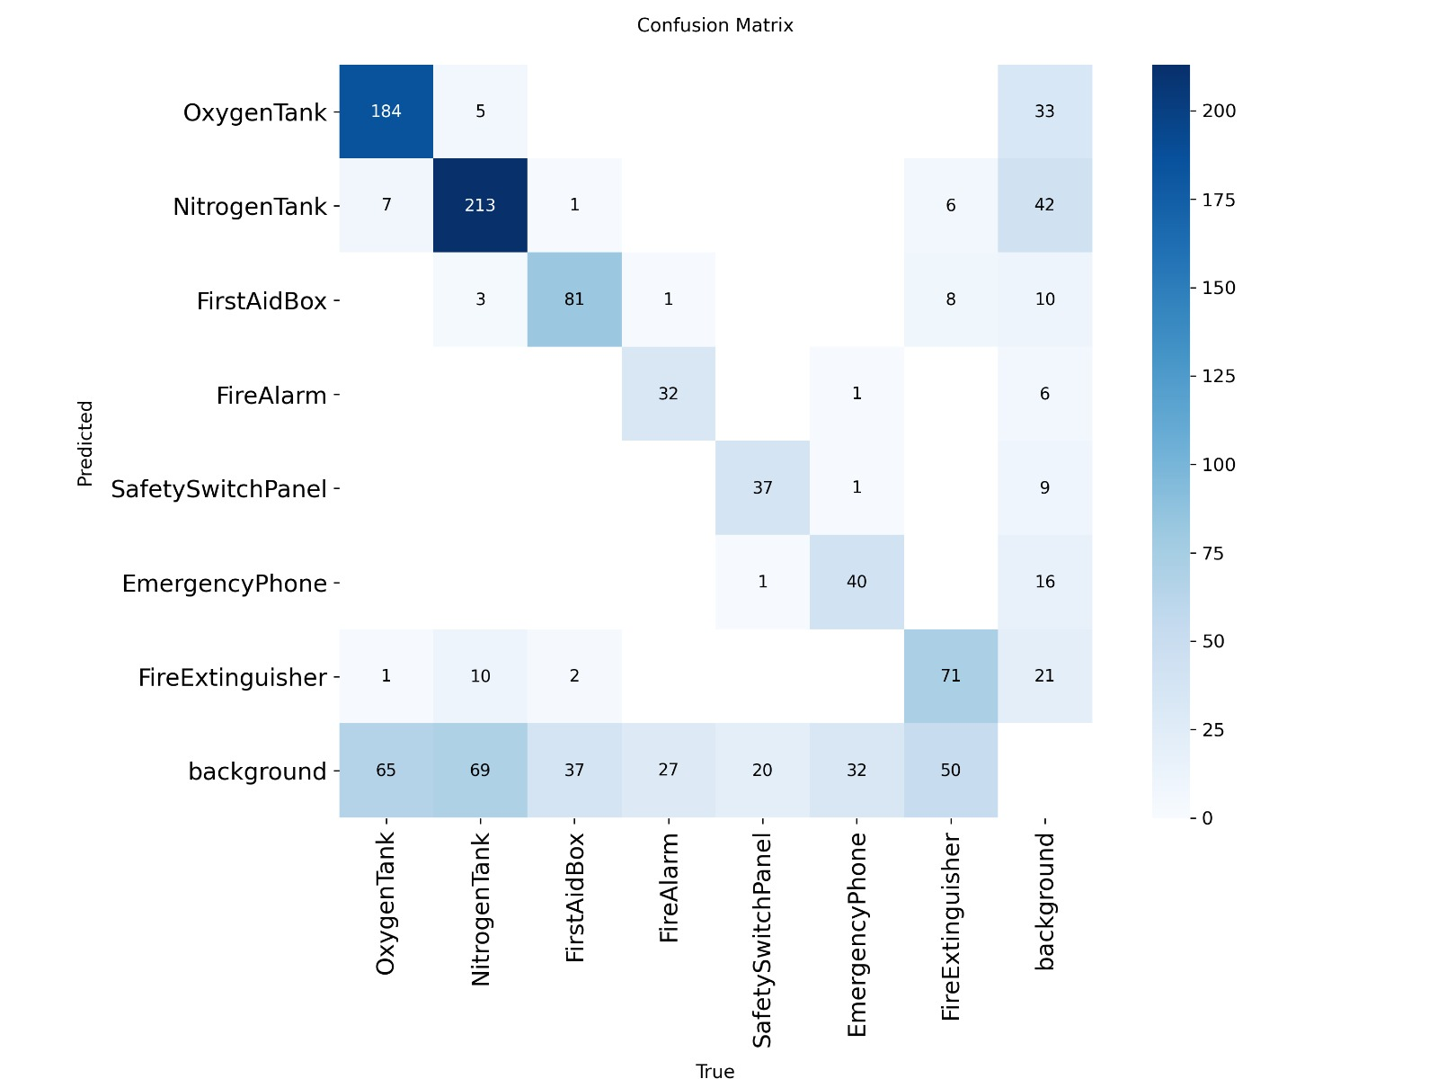
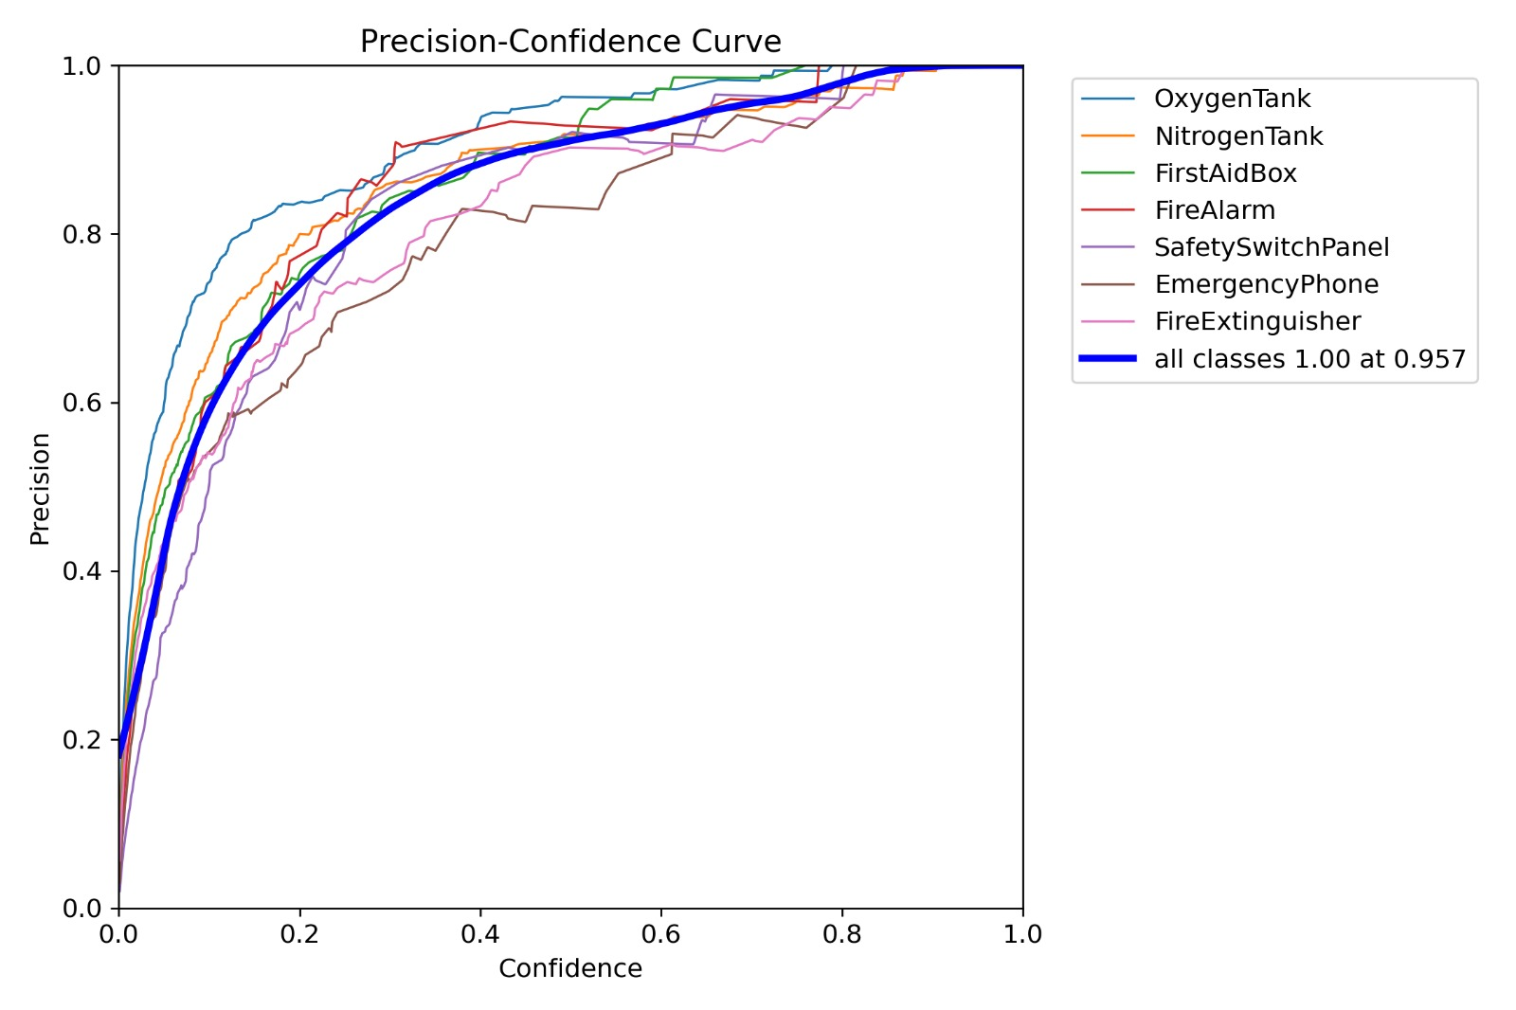
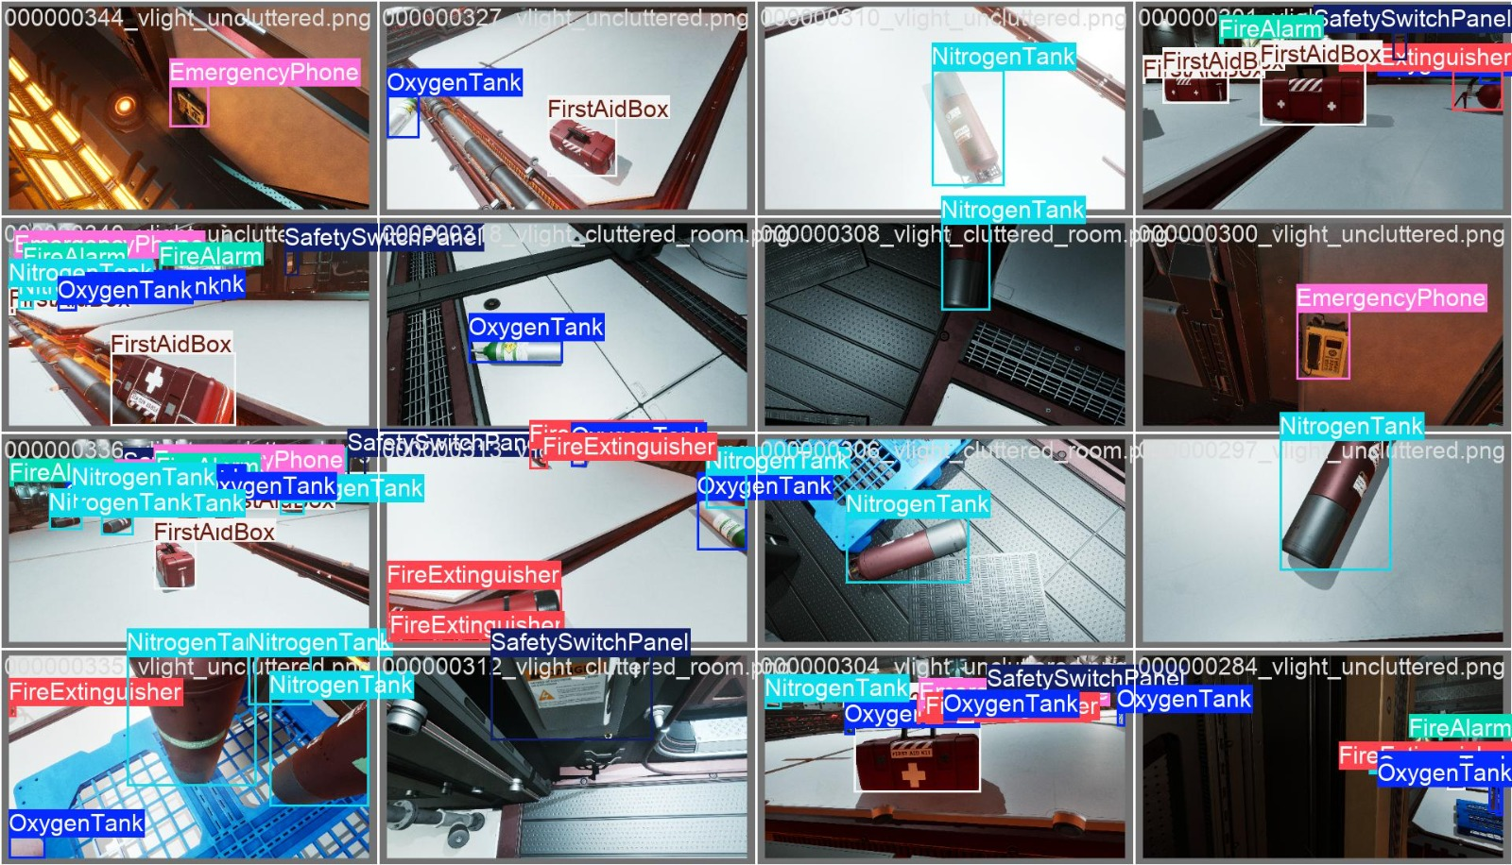
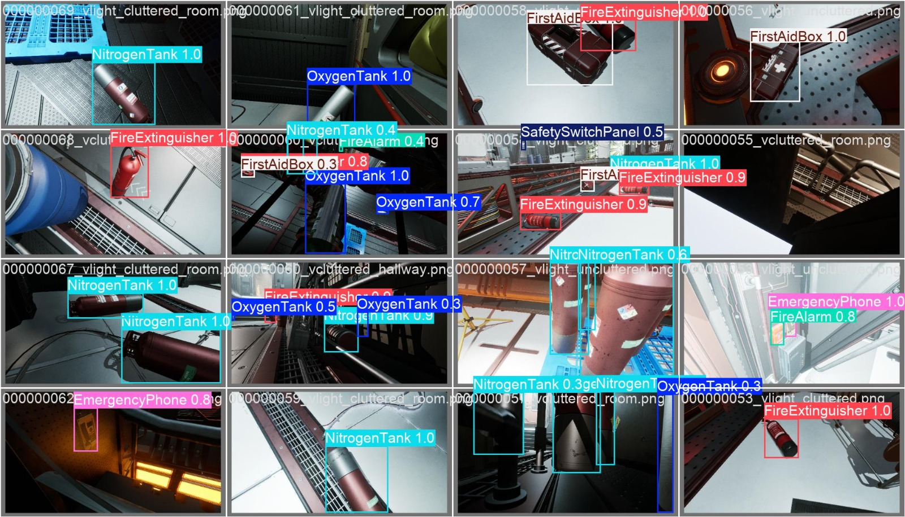
Prediction Result

Slide 9
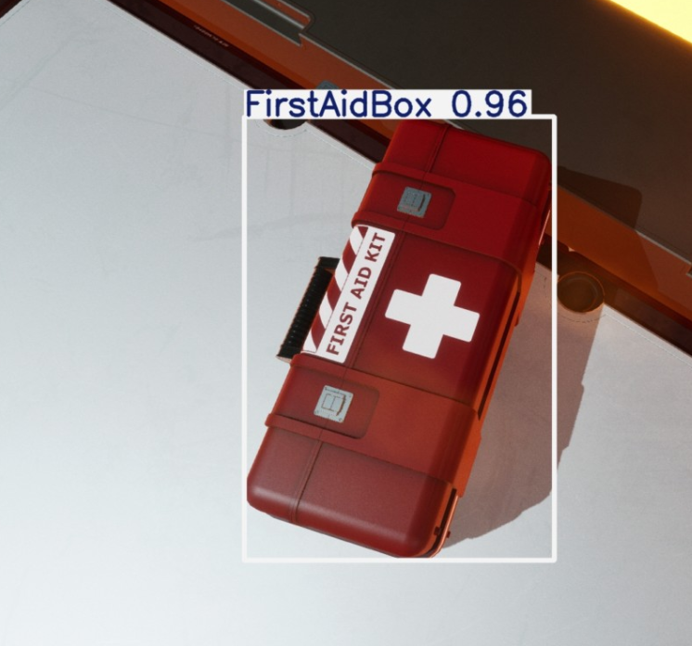
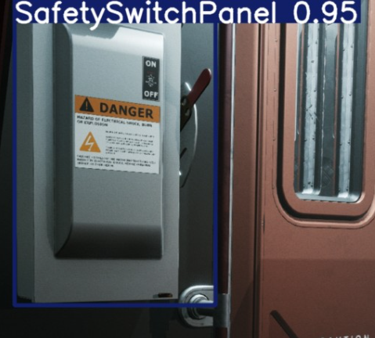
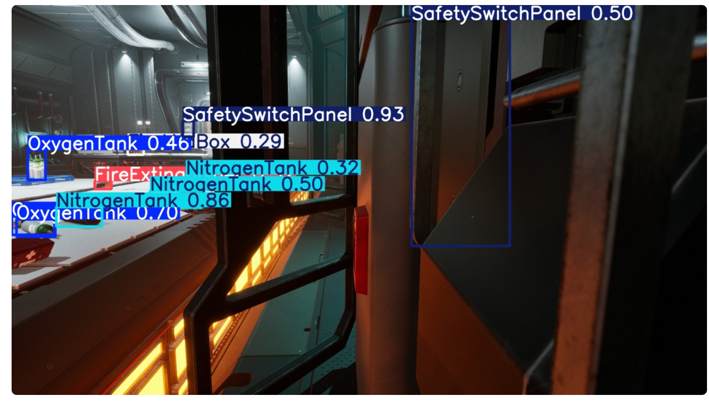
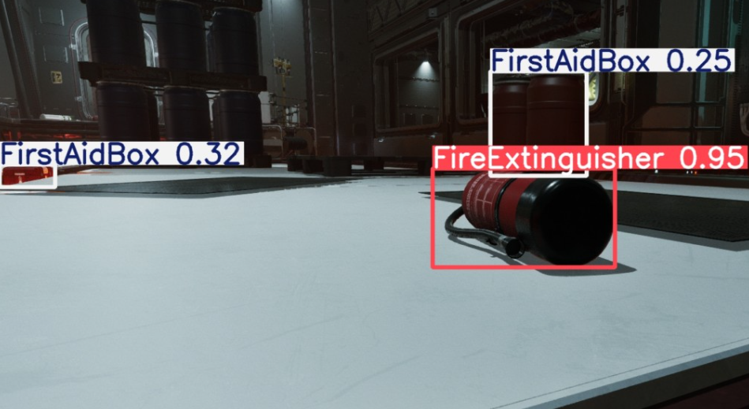
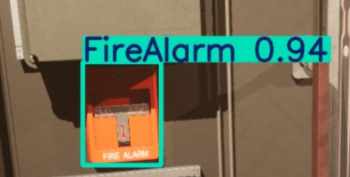

Slide 10
Future Improvements/processes
The Safety Object Detection system demonstrates how AI and computer vision can significantly enhance workplace safety by enabling real-time monitoring, automatic detection of critical safety equipment (such as Oxygen Tanks, Nitrogen Tanks, First Aid Boxes, Fire Alarms, Safety Switch Panels, Emergency Phones, and Fire Extinguishers), and instant alerts for violations. With the integration of OpenCV for video processing and a Streamlit interface for seamless interaction, the system reduces human error, ensures regulatory compliance, and helps prevent accidents.
Future Improvements & Extensions
Edge AI Deployment – Running the model on edge devices (Jetson Nano, Raspberry Pi) for faster, low-latency, offline detection.
Multi-Camera Support – Expanding the system to handle multiple CCTV feeds simultaneously.
Advanced Alerts – Integration with IoT devices (sirens, SMS, email, mobile notifications) for stronger incident response.
Analytics Dashboard – Adding dashboards in Streamlit to track detection trends, safety violations, and compliance reports over time.
Model Enhancement – Improving accuracy using larger datasets, synthetic data generation, and advanced models (YOLOv8, Transformer-based detectors).
Scalability – Cloud deployment for large industrial sites, allowing centralized monitoring across multiple locations.
This roadmap makes the system not only practical today but also scalable and adaptable for future industrial safety needs.

Slide 11
Conclusion
The Safety Object Detection system showcases how AI and computer vision can significantly enhance workplace safety by enabling real-time monitoring, automatic detection of critical safety equipment (such as Oxygen Tanks, Nitrogen Tanks, First Aid Boxes, Fire Alarms, Safety Switch Panels, Emergency Phones, and Fire Extinguishers), and instant alerts for violations. With the integration of OpenCV for video processing and a Streamlit interface for seamless interaction, the system reduces human error, ensures regulatory compliance, and helps prevent accidents. Its cost-effectiveness, scalability, and easy integration with existing infrastructure make it a practical and future-ready solution for organizations dedicated to maintaining safe and compliant work environments.

Slide 12

Important links
Github: https://github.com/mohammadasifbaig87/Ai-Innovators-safety_object_detection
DriveLink: https://drive.google.com/drive/folders/1Ghcsv3U5fuy0iR-0uULn8EKvu6ZZIMP-?usp=sharing
Sample Working Video: https://github.com/mohammadasifbaig87/Ai-Innovators-safety_object_detection/blob/main/video/2025-09-21%2016-29-27.mkv
Project Report(Documentation):https://tinyurl.com/y7k8uh29

